Slide 1

Post-Secondary Planning
Juniors Class of 2026
Testing
Part II
Standardized Testing
Notes:
Our presentation now is focused on standardized testing. We understand that many of you are at various stages of the college exploration process. The conversation now is geared toward students who are starting to think about their college options that have standardized testing as a something that is necessary.

Slide 2
AGENDA
College related testing timeline
Resources
Notes:
While the topics that I am discussing focus on preparing for college, we also understand that the “University for All” philosophy is not the best fit for all. And while SAT/ACTs and college planning may be a part of your family conversation, we want to stress the importance of the individual timeline and individual path.

Slide 3



College-Related
Testing Timeline
PSAT
SAT/ACT
Advanced Placement
(AP) Tests
Winter/Spring junior year; Summer/Fall senior year; Immediately after prep course.
*Register through ACT/College Board
October
Review results online (Nov) to prepare for future SAT
First 2 weeks of May; same year as AP course
Notes:
There are a number of assessments used by colleges in the admissions process. PSAT and PreACT are practice tests for the SAT and ACT. Registration for ACT and SAT are done directly through the College Board or ACT site and not through CBSD.
When to test is a personal decision. We suggest waiting to take the SAT or ACT in the spring because the more academic work the students have completed, the better they do on the exams. However, this is a personal decision based on readiness. Students should minimally complete Algebra 2 which is covered on the math portion of both tests.
Some students are taking prep classes and their instructors are encouraging them to take the exams sooner, which is fine.
Students do not need to take the SAT or ACT if they are going to be attending a Community College. However, if students want to transfer, typically they will need either the SAT or ACT if they have not yet completed an associate's degree or equivalent (unless they are applying to a school that offers a “test optional” model). Please note that schools do not place the same weight on SAT/ACT scores as they did in years past, but some colleges may require them.

Slide 4
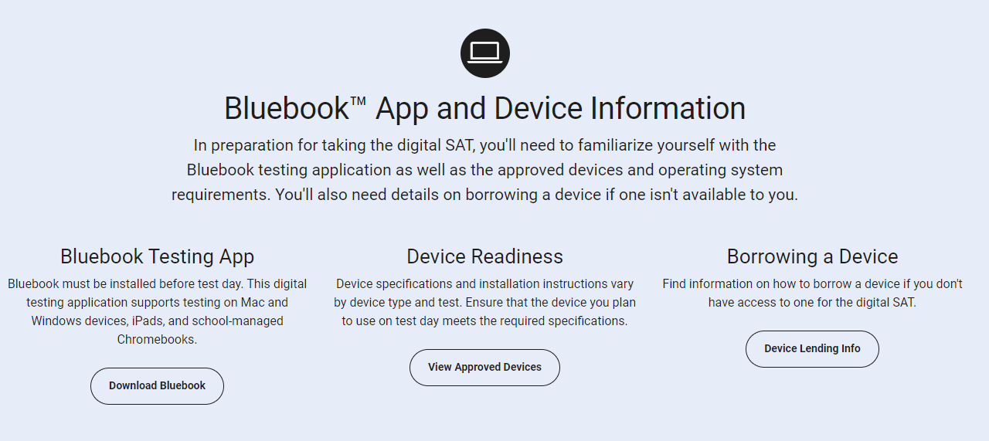
Notes:
Blue Book has automatically been pushed to all CBSD Issued laptops. We recommend that students become familiar with the platform and the testing experience prior to any testing day.
There are practice questions on BlueBook that students can work through to prepare.
All students should open Bluebook in the days prior to any PSAT, SAT, or AP test to make sure they upload any new updates that have been pushed out through College Board so there are no issues on testing day.

Slide 5
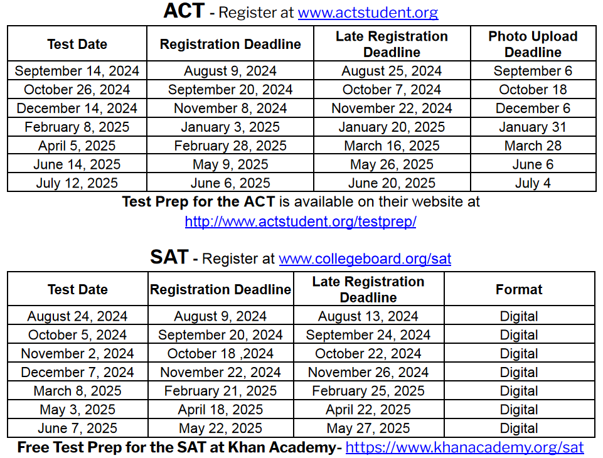

Slide 6

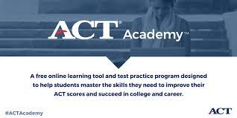



Test prep resources
Fairtest.org
ACT Academy
Through ACT
EPrep
Khan Academy
Private test Prep
CB East Electives
See CB East Librarian
Through CollegeBoard
Math and English
Notes:
There are dozens of resources available, most for free, that students can access to prepare for the SAT or ACT. These are just a few.
Check out Fairtest.org for a list of colleges that do not require standardized tests for admissions. These schools are called “TEST OPTIONAL” schools. We will discuss Test Optional in a moment.

Slide 7

Reporting Test Results to Colleges
Directly to college from testing company upon student request
May take up to 4-6 weeks
When registering for tests, students can request scores be sent to up to 4 colleges for FREE. Scores rec’d by college in 2 weeks
Test scores are NOT ON YOUR TRANSCRIPT
Is “Score Choice” the right choice or should I send all scores?
“Super-scores” are calculated by most colleges
Official
Score
Reports
Growing trend in admissions
Option to take picture of score report and submit
Official score report required by college you choose to attend
Self-Report
When registering for any standardized test, be sure to include
CB East school code 390-488 and check Parent Portal to make sure scores have been sent to East to include in your Naviance statistics.
Notes:
SAT/ACT Scores are NOT on the High School Transcript.​ CBSD does NOT send your test scores to colleges.
If you want a college to receive scores, you must have them sent directly from CollegeBoard or ACT. Once your SAT scores are available online (about 13 days after the test), if you order your score reports it will take approximately 1-2 weeks for a college to receive your SAT scores.​
While they will give you 4 free score reports to send to colleges at the time of registration, sending score reports after the scores are released will cost a fee.​
SCORE CHOICE: You can pay an additional fee to “hide” the scores from a particular test date. However, most colleges want to see all scores and will just pull the best scores for consideration, so don’t feel you need to pay to “hide” lesser scores.​
​
SUPER-SCORES: Most colleges “super-score” the SAT – take the highest math, verbal, and writing and combine those scores. (Penn State takes highest test DATE, not super score).​

Slide 8

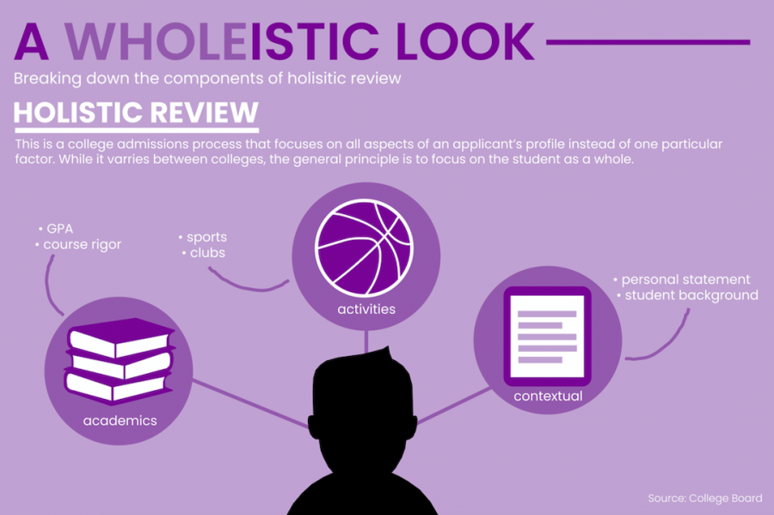


Notes:
During COVID, many schools went test-optional as testing centers became scarce and students could not access centers.
Colleges began to become skeptical about whether SAT/ACT scores were good predictors of college success or whether they simply favored those who had means and access to test-prep opportunities.
Many schools have continued to stay test-optional, though we may not know for our Class of 2026 what the policies will be for institutions until later in the spring.
It would be important to research if any specific merit scholarships at a college require SAT/ACT scores. It is also very important to know that while a college might be test optional, there might be specific majors that do require scores, such as nursing and engineering.
It is important for Juniors to get involved in activities and give those activities their full commitment.
Juniors are also encouraged to save a graded writing sample from one of their classes in case a college asks the to submit additional materials to be considered.

Slide 9

When? First full 2 weeks of May @ CB East during school day.
How? Register through Mypaymentsplus
Cost? $104
*Course registration and payment deadline varies based on when AP course began*
Potential benefits of AP
College credit
Course level placement
“Place out” of college courses.
Advanced academic standing
Rigorous preparation for college coursework
Who takes AP Credits?
www.collegeboard.org/ap/creditpolicy
Notes:
We will have two mypaymentsplus collection periods. One for the AP courses that begin 1st marking period, and one for AP courses that begin 2nd or 3rd marking periods- usually end of January/Beginning of February.
Join code is provided by teacher.
There are some benefits of taking the AP exam if a student is taking an AP course:
Will they be given elective credit?
Core credit?
Exemption from a pre-req
Registration and payment information will be sent out through Dr. Watter’s newsletter and sent via email by Mr. Moustakas.
Nov 3rd was the deadline to register for classes that began in the 1st MP; Registration for later courses will open in February.
Students should check each college’s individual policies about how/if they will accept AP credit.

